Slide 1
This clinical refresher is an opportunity to learn more about a procedure or clinical activity for which one has had a previous learning experience. This activity is not intended to be an initial learning experience. In order to effectively and safely perform the procedures depicted in this refresher, one must have additional didactic clinical learning experiences. Participating in this type of clinical refresher in isolation of other learning experiences does not qualify an individual to conduct the procedure or clinical activity covered by this clinical refresher. The activity is intended to support the maintenance of professional qualifications of nuclear medicine technologists.

Slide 2
Hepatobiliary Imaging

Slide 3
Background
1950s: Iodine-131 Rose Bengal used to evaluate hepatic uptake and excretion, neonatal hepatitis vs biliary arteria
Scintillation well counters and probes
Slow transit time and high radiation burden
Late1970s and 1980: technetium radiopharmaceuticals became the standard
Improved resolution
Reduced radiation burden
Applicable to current gamma camera technology
“HIDA” is the general term for any technetium-based hepatobiliary radiopharmaceutical

Slide 4
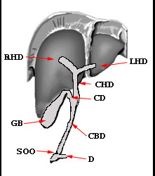
Rationale
After IV administration of HIDA, hepatocytes pick up tracer
HIDA and bilirubin compete for the same sites on hepatocytes
HIDA becomes incorporated into the production of bile
Excessive levels of bilirubin (>20mg/dL) may effect and/or reduce HIDA uptake
The presence or lack thereof may indicate a problem
HIDA flows to the right/left hepatic ducts (R/LHD), fown the common hepatic duct (CHD), into the cystic duct (CD)/gall bladder (GB), fown the common bile duct (CBD), passes the sphincter of oddi (SOO), and dumps into the duodenum (D), or small intestine.
www.people.vcu.edu/~mhcrosthwait.

Slide 5
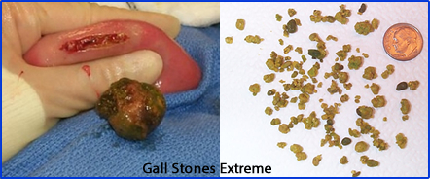
Indications⁷
Primary reason for a HIDA scan
Suspected cystic duct obstruction (acute cholecystitis) usually caused by a stone lodged in the cystic duct
Rule out any blockage along the hepatobiliary tree
Assess outcome of a liver transplant; post-surgical leaks
Biliary atresia vs neonatal hepatitis
Bile reflux
Patient symptoms
Pain in the right side of the
abdomen
Jaundice
www.people.vcu.edu/~mhcrosthwait.

Slide 6
Contraindications⁷
Pregnancy or breastfeeding
Follow institutional guidelines
Hypersensitive to HIDA
Patient should be off of all opiates
May cause constriction of the SOO
NPO ≥ 24 hrs
Causes GB stasis; requires pre-treatment of sincalide

Slide 7
Radiopharmaceuticals³
^{99m}Tc-Lidofenin (HIDA)
Limitation – poor imaging results when bilirubin level is greater than 8mg/dL²
Patients with normal liver functions -15% is excreted by the kidneys
^{99m}Tc Disofenin (DISIDA/Hepatolite)
Increased uptake in the liver with less renal excretion
Hepatic tree visualized up to 20mg/dL of bilirubin
^{99m}Tc Mebrofenin (BROMIDA/Choletec) were later developed
Has 98% hepatobiliary uptake
Least effected by higher levels of bilirubin

Slide 8
Patient Medical History⁷
All medications, lab values and surgeries
Review previous imaging studies
History of hepatobiliary problems: e.g., acute cholecystitis and stones
Problems following a cholecystectomy, other surgeries
Fever, belly pain, vomiting
New RUQ pain
In an infant, jaundice may indicate biliary atresia

Slide 9
Patient Prep / Education
Patient Prep
NPO 4 - 6 hrs; < 24 hrs
Taken off TPN if applicable
D/C all forms of opiates
Patient Education
Imaging lasts at least 1 hour; additional delayed images possible
Stomach discomfort possible with sincalide
Outpatients must have a designated driver in case morphine is used

Slide 10
Imaging Preparations⁷
If patient is NPO > 24 hrs or on TPN, administer sincalide 1/2 hr prior to HIDA injection
If on an opiate, d/c opiate prior to HIDA injection
Morphine sulfate PO - 2 to 4 hrs
Morphine sulfate IV - 2.1 to 2.6 hrs
Dilaudid - at least 8 hrs
Fentanyl transdermal patch – at least 80 hrs

Slide 11
General Acquisition Parameters
Large FoV
Collimator: LEGAP or LEHR
Imaging matrix size
Dynamic: 128 x 128
Static: 256 x 256
Suggest zooming on pediatric pts
Energy window set at 20%; peak at 140 keV
Dosing via IV injection
Adults: 6 mCi (222 MBq)
Pediatrics: 0.05 mCi (1.85 MBq)/kg⁸

Slide 12
Image Acquisition
Start imaging after radiotracer administration
Dynamic Protocol
Take 1-min images for 60 min
Study is completed when activity seen in GB and small intestine
Static Protocol
Normal plan: every 5 min for up to 1 hr
Each image should be 500k to 700k counts
256 x 256 matrix
If GB uptake questionable
Additional static images
LAO, RAO, and/or R-LAT to rule out bowel loop
http://www.nucmedreview.com/cases/gi/gi.html.

Slide 13
Image Acquisition (cont.)
If GB and/or small intestine not visualized
Continue until GB and small bowel are seen
Continue until all activity leaves the liver (3 – 4 hrs)
If complete blockage, imaging may take up to 24 hrs
If activity dumps into the small bowel but not seen in GB at 1 hr post-injection, consider giving morphine sulfate (MS)
MS constricts SOO, causes pressure to build up in CBD
If no blockage, activity enters GB; exam is completed
MS dose/administration/imaging
0.04 mg/kg of body wt
IV administration for 2 - 3 mins
Image dynamic or static for 30 - 60 additional mins
If GB appears - the study is normal.
If GB does not appear - pt has acute cholecystitis

Slide 14
Sincalide/Kinevac Augmentation¹¹
GB stasis occurs if pt has been NPO >24 hours or if on TPN. To stimulate GB contraction, give Kinevac
Dose: 0.02 µg/kg of body wt over 30 - 60 min
Assessment of GB ejection fraction
If activity dumps into small bowel and GB is at maximum fill (30 - 60 min post-injection), administer Kinevac (use above dose)
Infusion times
Administer dose over 60 min; take images 1 min per frame⁵
The 3-min dose protocol uses a syringe pump for even tracer distribution
NOTE: the 3-min protocol may cause significant nausea compared to the 60-min method

Slide 15
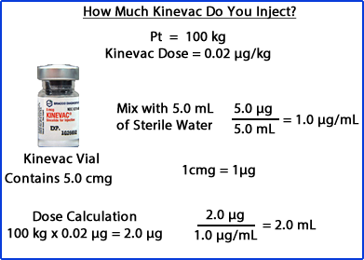
Compounding and Administering Kinevac
www.people.vcu.edu/~mhcrosthwait.

Slide 16
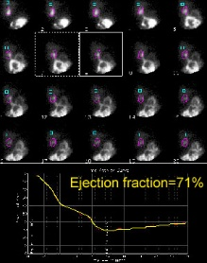
Image Processing
Ziessman et al: 60-min Kinevac admin⁹
First min: pre-Kinevac administration
Dynamic acquisition
ROIs drawn around GB and BKG
Time active curve is generated
≥ 38%: EF is normal
Below 38%: acalculous cholecystitis
Use the following formula for GBEF
https://www.auntminnie.com/Acute Cholecystitis. Accessed 8-16-20.

Slide 17
Substituting Sincalide⁹
If sincalide is not available, a lactose-free, fatty meal protocol can be used:
Administer 240 mL of lactose-free supplement (Ensure Plus) containing 11.4 gm of fat
Image acquisition: 60 min set at 1-min per frame
Using the EF formula from previous slide: draw ROIs around the GB and generate time activity curves
The normal lower limit should be 33%
Note: This method is not as reliable as using sincalide

Slide 18
Combining MS with Kinevac
Following the administration of MS and the visualization of the GB, there may be a need to determine gal bladder ejection fraction
The concern with this approach - contraction of the SOO may falsely lower the ejection faction when Kinevac is given
Achong and colleagues concluded that normal ejection fraction can be determined if there is a 30 minute delay between MS and Kinevac¹⁰

Slide 19
Normal Hepatobiliary Scan – 1 Hour Dynamic
Initial images show normal perfusion into hepatic cells
As time progresses activity is seen in the right and left hepatic duct
Activity continues down the common bile duct, fills GB, dumps into the small bowel
Caveat - Bile reflux is noted on the last image
www.people.vcu.edu/~mhcrosthwait.

Slide 20
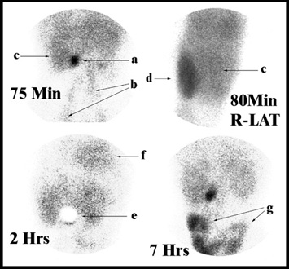
Partial Obstruction
Image legend: a – GB, b – femoral arteries, c – liver, d – kidney, e – shielding GB, g – small bowel
High bilirubin level; causes poor tracer uptake
75-min image
Activity still in vascularture
Poor uptake in the GB
Hepatobiliary tree not seen
80-min image
Kidney uptake
Indicates high bilirubin
7 hrs post-dose: small bowel finally seen
Note: lengthy imaging time to tracer visualization indicates partial obstruction
www.people.vcu.edu/~mhcrosthwait.

Slide 21
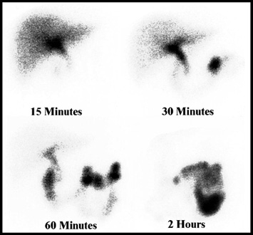
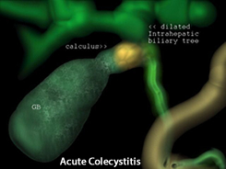
Acute Cholecystitis
30 min post-injection
Activity seen in the small bowel
2 hrs post-injection
No activity in the liver
GB not visualized
Extensive activity in the small bowel
www.people.vcu.edu/~mhcrosthwait.
Left: http://www.ultrasound-images.com/gall-bladder.htm

Slide 22
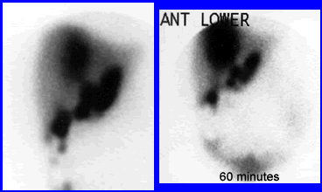
Bile Leak
Post-laparoscopic cholecystectomy
Pt returned to ER 10 days
Abdominal pain
Vomiting
Low-grade fever
Imaging shows leak caused by the surgery
www.people.vcu.edu/~mhcrosthwait.

Slide 23
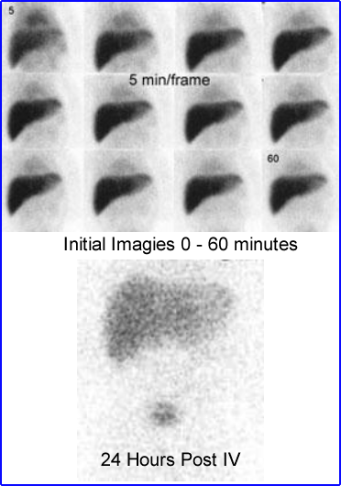
Biliary Atresia
Pediatric Pt: biliary atresia vs neonatal hepatitis
Prior to exam: pretreat pt with phenobarbital to enhance bile flow
Suggested dose prior to procedure
5mg/kg/day for 5 days
These images are an example of no activity flowing out of the liver into the hepatobiliary tree. Activity seen only in liver and urinary bladder at 24 hrs.
https://www.slideshare.net/jiraporn_biliary atresia. Accessed 8-16-20.

Slide 24
References
Taplin, et al. J Lab Clin Med 1955 May;45(5):665-78.
Wochenschr SM. Hepatobiliary scintigraphy: a functional test. 1978 Dec 2;108(48):1896-9.
Datz FL. Handbook of Nuclear Medicine, 2nd Edition, Mosby 1992.
Tc-99m BrIDA Hepatobiliary (“HIDA”) Scan (online) http://www.nucmedresource.com/hepatobiliary-hida-scan.html.
Ziessman HA et al. 2010 J Nucl Med. 2010;51:277-281 (online) http://jnm.snmjournals.org/content/51/2/277.full.pdf.
Kwatra N, et al. Pediatr Radiol 2013;16(10):1365-75 (online) https://link.springer.com/article/10.1007%2Fs00247-013-2704-3.
Tulchinsky M, et al. SNM Practice Guideline for Hepatobiliary Scintigraphy 4.0. J Nucl Med 2010 Dec;38:4 (online) http://snmmi.files.cms-plus.com/docs/Hepatobiliary_Scintigraphy_V4.0b.pdf.
Treves, ST. Pediatric Nuclear Medicine. New York: Springer 1995.
Ziessman HA, et al. J Nucl Med 2003;44(3) 1263-1266 (online) http://jnm.snmjournals.org/content/44/8/1263.full.
Achnog DM, et al. Clin Nucl Med 1999;NOv24(11):837-841 (online) https://pubmed.ncbi.nlm.nih.gov/10551461/
Krishnamurthy, GT, et al. Comparison of Fatty Meal and Intravenous Cholecystokinin Infusion for Gallbladder Ejection Fraction. (online) http://jnm.snmjournals.org/content/43/12/1603.full.pdf+html. J Nucl Med December 1, 2002 vol. 43 no. 12 1603-1610

Slide 25
This online educational activity is provided free of charge to nuclear medicine technologists through funding by The American Registry of Radiologic Technologists (ARRT) to the Society of Nuclear Medicine and Molecular Imaging (SNMMI).
The clinical refreshers are the property of SNMMI, who also possesses the copyright in the works and makes them available to interested health care professionals via a license.

